Slide 1

SYSTEM ANNUAL BUDGET 2026-2027

Slide 2
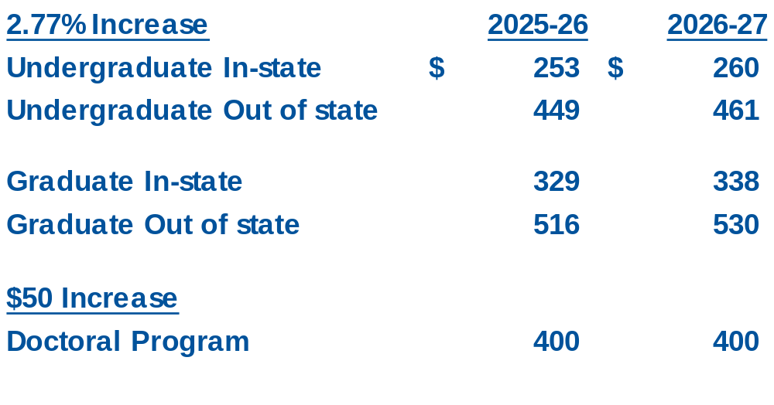
PROPOSED TUITION

Slide 3
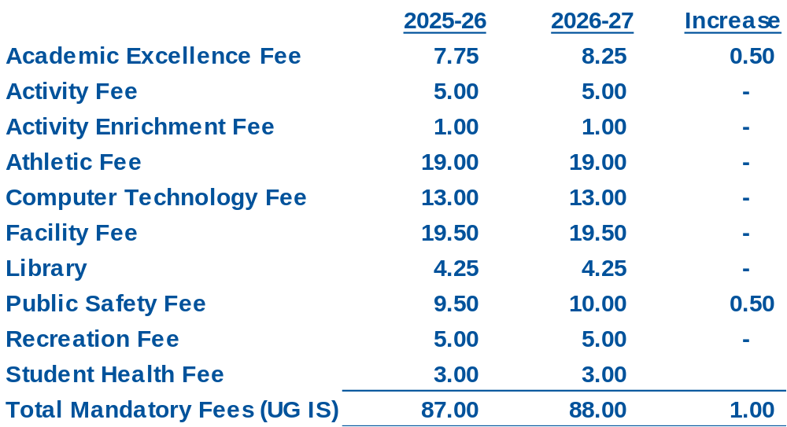
PROPOSED FEES

Slide 4
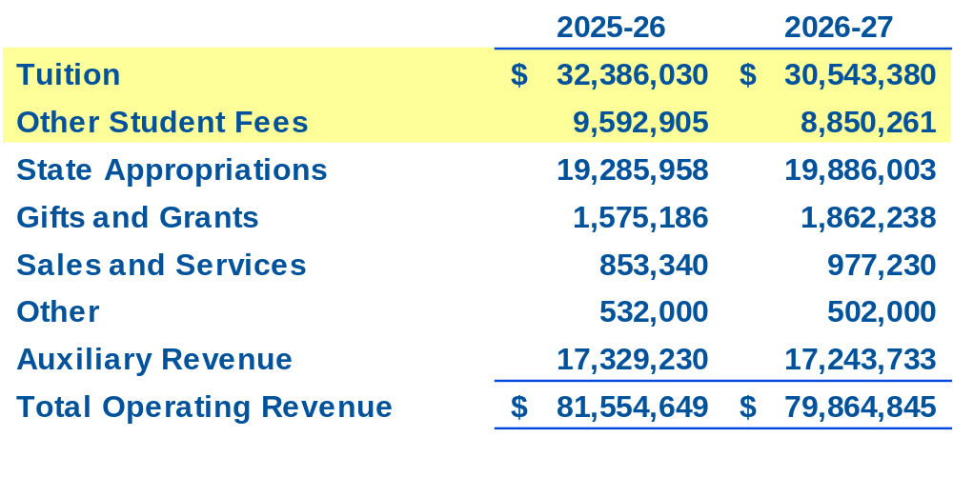
REVENUE BUDGET COMPARISON

Slide 5
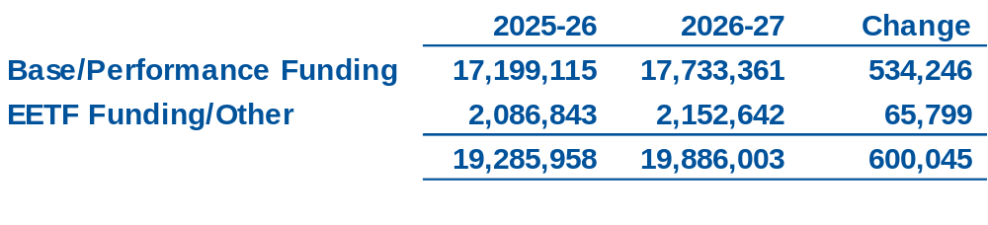
STATE APPROPRIATIONS

Slide 6
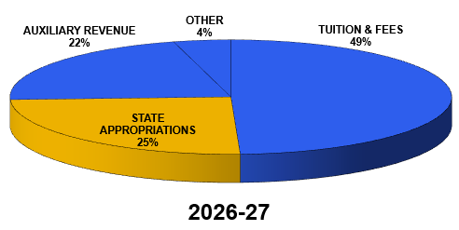
REVENUE BUDGET

Slide 7
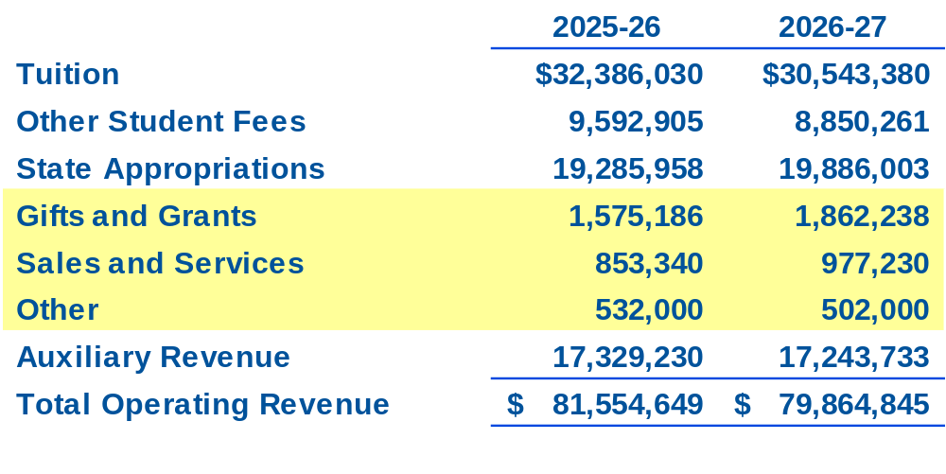
REVENUE BUDGET COMPARISON

Slide 8
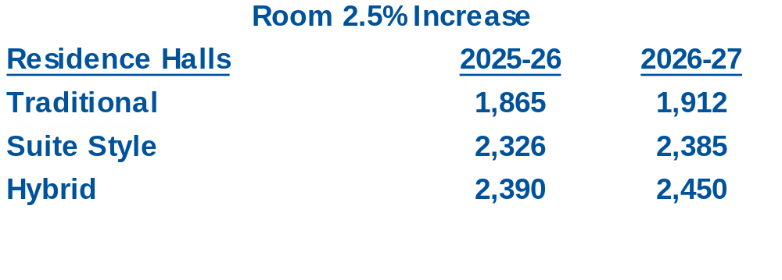
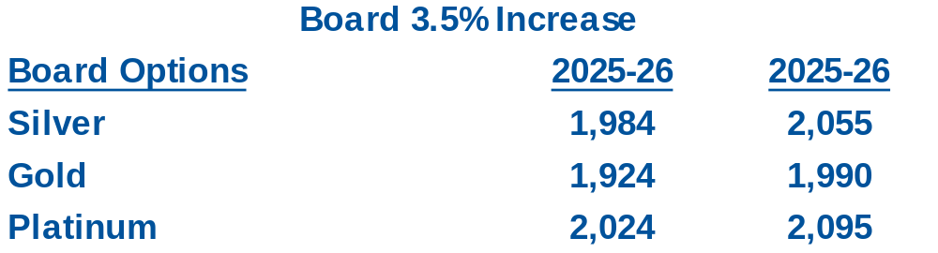
PROPOSED ROOM AND BOARD

Slide 9
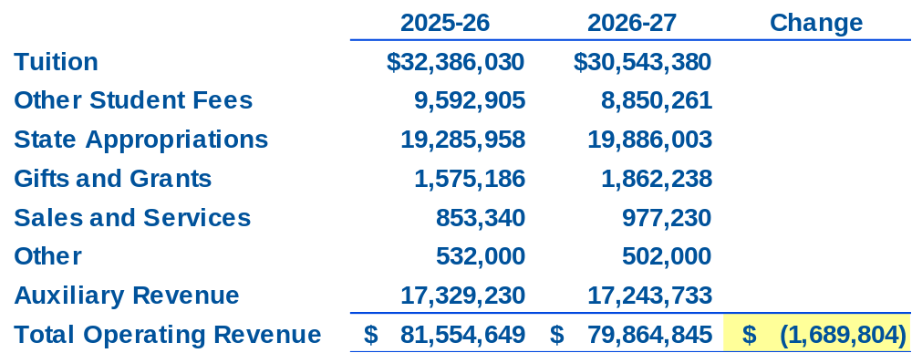
REVENUE BUDGET COMPARISON

Slide 10
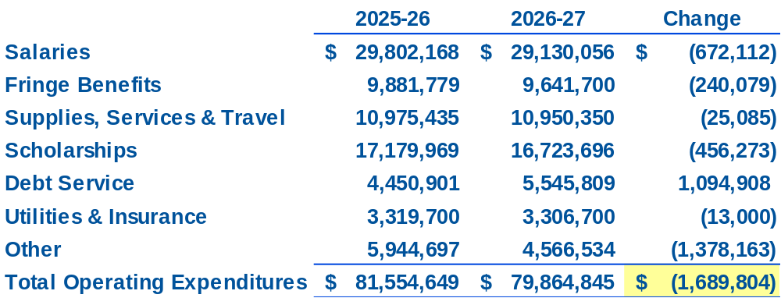
EXPENSE BUDGET COMPARISON

Slide 11
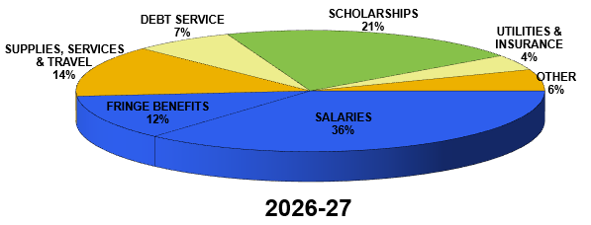
EXPENSE BUDGET

Slide 12
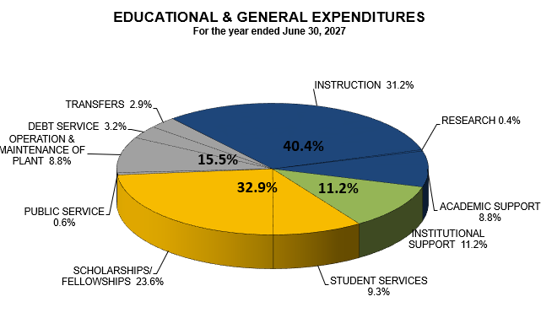
EXPENSE BUDGET

Slide 13
EXPENDITURES
  Reflects:
  Temporary hold on 12 vacant positions and associated fringe benefits
  Scholarship reduction to align with the actual number of students eligible for merit-based scholarships and out-of-state waivers
  Privatized housing asset acquisition resulting in $318,285 of annual operating savings through changes in transfers and debt service
  Maintenance and service contract increase associated with the Jenzabar administrative software implementation and support

Slide 14
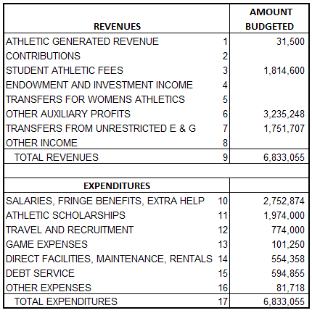
ATHLETIC BUDGET CERTIFICATION
There is a $19 per credit hour charge dedicated to athletics

Slide 15
QUESTIONS?

